Slide 1
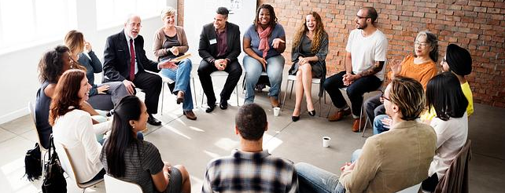
For as we have many members in one body, but all the members do not have the same function, so we, being many, are one body in Christ, and individually members of one another. Having then gifts differing according to the grace that is given to us, let us use them… (Rom. 12:4-6a).
There are diversities of gifts, but the same Spirit. There are differences of ministries, but the same Lord. And there are diversities of activities, but it is the same God who works all in all (1 Cor. 12:4-6).
All Scripture is taken from the New King James Version®. © 1982 by Thomas Nelson, Inc. Used by permission. All rights reserved.
Team Skills Inventory
Team Building Basics

Slide 2

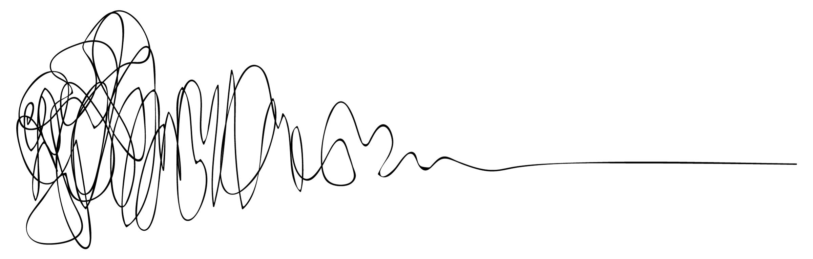
Personality Shapes
What’s Your Shape?

Slide 3
Zone of Proximal Development
Team Skills Inventory
3-circle drawing for ZPD
A learner increases his skill by working with someone 1 step ahead.
An outer ring of skill is still beyond learner.
Example of ZPD—baby learning to walk; learning to ride a bike.
Learners do better with someone who will meet them in the middle circle..
Picture of scaffolding
Learners receive support like a scaffold in layers so they can reach higher.
Teams Skills Inventory helps leaders form teams of translators that can work well together.
Should be done at beginning of workshop.
Group translators with others of similar skill level.
Skills assessed: GL ability, HL ability, Bible knowledge, Tech Knowledge, thinking style.
What kinds of needs might keep translators from focusing on work?
How do leaders at a MAST event help provide for these needs so translators can learn and work?
ZPD
Learner can do with guidance
Learner can do unaided
Learner cannot do

Slide 4
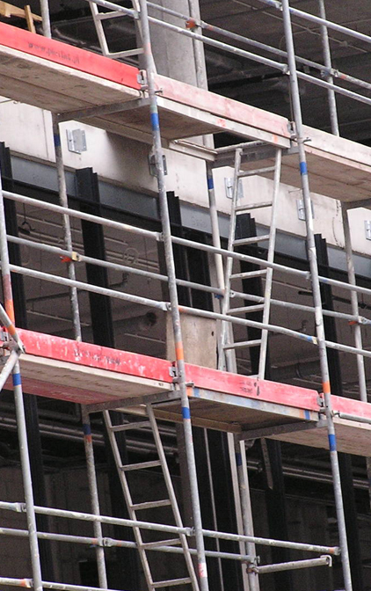
Scaffolding
Process of training students by providing support to reach higher
Notes:
Automatic build

Slide 5
Assessing Translators for Group Placement
1
2
3
4
LC translators supported for the ZPD “mid-circle”
Leader:
regroup
LC translators
with
HC translators
Scaffold
Notes:
Click to build each number

Slide 6
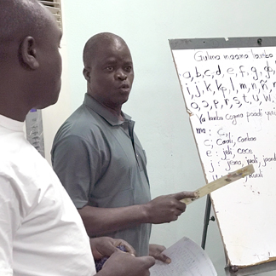
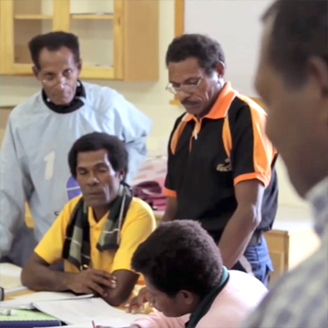
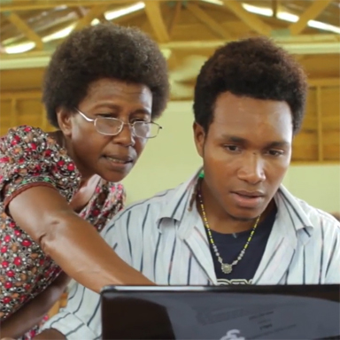
Team Skills Inventory
GL ability
HL ability
Thinking style
Bible knowledge
Tech Knowledge
Form teams that work well together
What needs prevent translator focus?
How will MAST leaders provide for these needs?

Slide 7
Station 1: Gateway Language (GL) Fluency
NAME
Rate 1 low to 5 high
Ask translator to:
Read a 5-verse selection.
Summarize verses in GL.
Introduce themselves in GL.
Write something about another translator in GL.
1
2
3
4
5
6
Give each translator a final (averaged) score. The team leader will write the number in column 1 on the Master list.
Notes:
Click to build red box

Slide 8
Station 2: English Fluency
NAME
Rate 1 low to 5 high
Ask translator to:
Read a 5-verse selection.
Summarize in English
Introduce themselves in English
Write something about another translator in English
1
2
3
4
5
6
Give each translator a final (averaged) score, which will be written in column 2
Notes:
Click to build red box

Slide 9
Station 3: Heart Language (HL) Fluency, in pairs
Rate 1 low to 5 high
Ask translators to:
Introduce themselves in HL.
Write something about another translator in HL and read it out loud.
NAME
1
2
3
4
5
6
Give each translator a final (averaged) score to be written in column 3
Notes:
Click to build red box

Slide 10
Station 4: Thinking Style
Ask translator to spin in a circle
Did they spin left or right?
Ask which traits best describe them:
Left Brain:
Uses logic
Detail oriented
Facts rule
Words & language
Present & past
Math & science
Right Brain:
Uses feeling
“Big picture” oriented
Creative problem solver
Imagination rules
Symbols & images
Present & future
Philosophy & religion
Notes:
Automatic build

Slide 11
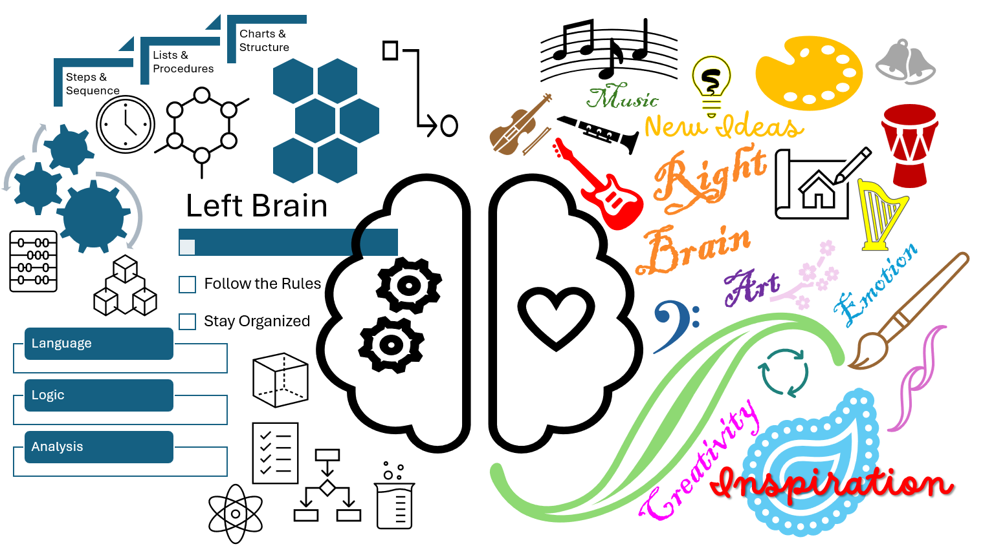
Station 4: Thinking Style (continued)
Ask translator :
Which picture best describes them
Which side of the brain fits them better
Write R or L on the translator’s assessment paper
Notes:
Automatic build

Slide 12

Station 4: Thinking Style (continued)
Ask translator: which shape represents them best
Why?
Compare answers to Right Brain, Left Brain qualities
Mark them as R or L
Notes:
Automatic build

Slide 13

Station 4: Thinking Style (continued)
Ask translator 2 questions:
What is this?
What would you like to say about it?
Mark them as A or B
Final score will look like:
NAME
1
2
3
4
5
6
RB: right brained, deep thinker and processer
RA: Right brained, takes things as they come, simple processor
LA: Left brained, simple processor
LB: Left brained, deep thinker and processor
The team leader will write the score in column 4
Notes:
Click to build red box

Slide 14
Station 5: Biblical Familiarity
Rate 1 low to 5 high
Ask the translator:
To rate themselves on Bible knowledge
Name the books of the New Testament
Who wrote Romans, Revelation & Hebrews
How much of the Bible have they read or heard read
Do they have any formal Bible training
NAME
1
2
3
4
5
6
Give each translator a final (averaged) score to be written in column 5
Notes:
Click to build red box

Slide 15
Station 6: Technology Skills
Rate 1 low to 5 high
Ask the translator to:
Turn on the computer / tablet
Follow your verbal directions to open the writing application
Type three sentences in the application
NAME
1
2
3
4
5
6
Give each translator a final (averaged) score to be written in column 6
Notes:
Click to build red box

